Slide 1


Bank of Baroda Hackathon - 2022
Technology Partner
Numerators
Your team bio : A group of like-minded individuals with aligned interests in Computer Vision and Transfer Learning.
Date : 20-09-2022

Slide 2
Problem Statement?
Automatic Cheque Processing Using Transformer Based OCRs and Azure Computer Vision.
Why?
Most of the banks still have manual methods for the task of cheque processing.In such a manual verification the various fields of date, payee details,courtesy amounts,signature, have to be visually verified.This causes mismanagement of resources,time and also does compromise security and performance due to it’s manual nature.
Current Advances in Computer Vision and Text Recognition have efficient tools to automate the entire process of recognition, verification and data entry.
Even still,there still remains a distinct vacuum in the market for a product like this which can efficiently perform the entire task with benchmark accuracy and security.
How?
Fine tune a Transformer based model and integrate it with azure computer vision for cheque processing.

Slide 3
User Segment & Pain Points
Which user /advertiser segment would be early adopter of your product & why?
1.User’s having to rely excessively on cheque payments should be the early adopters of our product as it will reduce the processing time and ease out the process of the cheque processing at a bank branch.
2.Smart systems with sensors/cameras can be used (like ATM machines) which can be deployed in an area with our mechanism for quick and no-visit processing of the cheques.
3. With this system we can also allow the customers to withdraw money upto certain limit using it through ATM machines (Enhancing ATM machines themselves) by using cheques.
4. If any error occurs in the processing of the cheque there’s a failsafe in the form of logs in the database which stores all the processed cheques for a said time period
5. In case of problems with the cheque, user can modify and edit the correct details then and there itself and will save valuable time which would have been lost in case of manual processing.

Slide 4
Prerequisite-
What are the alternatives/competitive products for the problem you are solving?
TrOCR: Transformer-based Optical Character Recognition with Pre-trained Models consists of an image Transformer encoder and an autoregressive text Transformer decoder to perform optical character recognition (OCR).It has pre-trained CV and NLP models.
MICR (Magnetic Ink Character Recognition) is a technology used to verify the legitimacy or originality of paper documents, especially checks. Special ink, which is sensitive to magnetic fields, is used in the printing of certain characters on the original documents.
Convolutional Recurrent Neural Network (CRNN) is a combination of CNN, RNN, and CTC(Connectionist Temporal Classification) loss for image-based sequence recognition tasks, such as scene text recognition and OCR.
Python-tesseract is an optical character recognition (OCR) tool for python. That is, it will recognize and “read” the text embedded in images.
Another python module which can be used is EasyOCR . It is an open source and ready to use OCR used for extracting text from the images.

Slide 5
Azure tools or resources
A list of Azure tools and resources likely to be used
Hugging Face on Azure
Azure Machine Learning Service.
Azure Computer Vision Service..
Azure Virtual Machines
Microservices by Azure
Azure API Management
Azure Database (Relational)

Slide 6
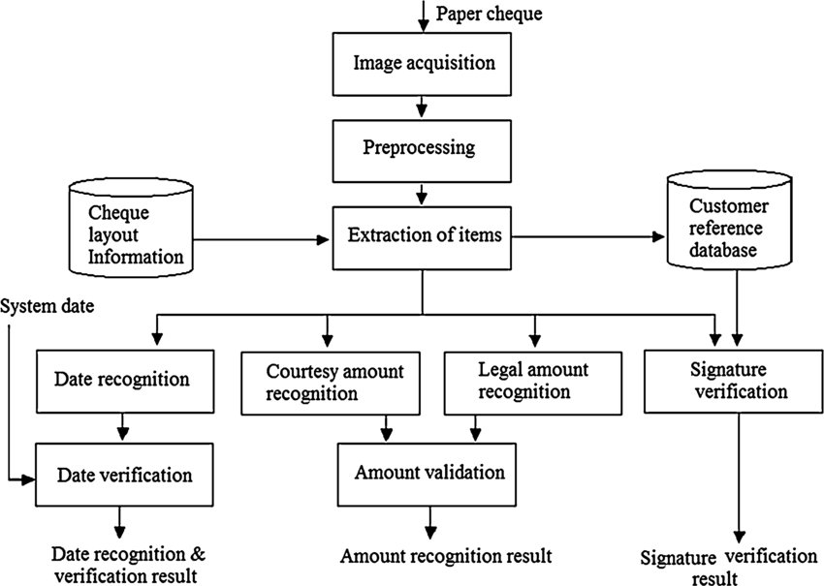
Any Supporting Functional Documents
Present your solution, talk about methodology, architecture & scalability
TrOCR
Computer Vision API
API
RDBMS
CI/CD Pipeline
Cloud Service
TechStack:
1. Azure OCRs (TrOCR)
2. Keras OCR
3. PyTorch
4.TensorFlow
5. RCNN
6. Easy OCR
7.Tesseract OCR

Slide 7
Key Differentiators & Adoption Plan
How is your solution better than alternatives and how do you plan to build adoption?
Talk about our companion models which we are going to use.
Availability of various options gives a chance to choose which model should we go with.
Transformer architecture’s self attention mechanism provides better results than traditional CNNs and RNNs to train for long range dependencies.
Transformer based models give great scope for transfer learning which can be heavily utilised for multilingual support,signature and handwriting recognition.
API will be generated which can be easily integrated with web or mobile applications for easy and hassle free adoption.
Our temporary storage database offers an additional fail safe method if there is any fault in the processing.

Slide 8
GitHub Repository Link & supporting diagrams, screenshots, if any
LINK : https://github.com/Mru911/Numerators_BOB

Slide 9
Thank You
Aditya Mavle
Gaurav Boob
Mrugank Deshpande
Venkatesh Soni

